Slide 1
GOLD PRICE FORECASTING
(Group 3)
Rohit Shewale
Shantanu Khamkar
Dhiraj Jogi
Maheshwari V
Pranjal Waghmare
Mentor : Karthik & Dhanyapriya

Slide 2
Business Problem
Objective:
Data provided is related to gold prices. The objective is to understand the underlying structure in your dataset and come up with a suitable forecasting model which can effectively forecast gold prices for next 30 days.

Slide 3
Project Architecture / Project Flow
Milestone | Duration
Kick off and Business Objective discussion | 1 day
Data set Details | 1 week
EDA | 1 week
Model Building | 1 Week
Model Evaluation | 1 week
Feedback
Deployment/ Final presentation | 1 day

Slide 4
Exploratory Data Analysis (EDA)
Data set details
Rows = 2182.
Columns = 2.
There is no null value in Dataset.
There is no Duplicate Value in Dataset.
The unique() function has returned the unique values which are present in the data and it is pretty much cool.

Slide 5
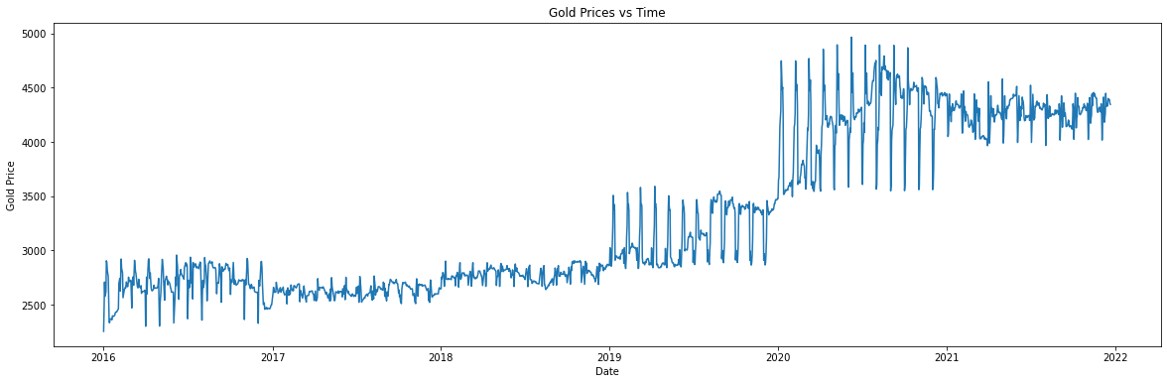
EDA (Visualization)
We can see that there is an increasing Trend. So, Trend is not constant.
Variance is also not constant.
The drastic increase in gold price after the year 2020 and there is intermediate fluctuation in 2021.

Slide 6
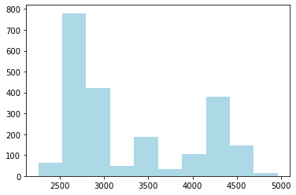
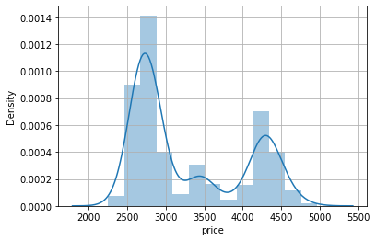
Plots for deep Visualization

Slide 7
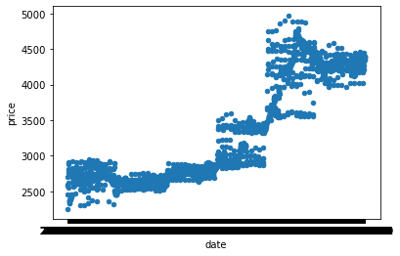
Using seaborn libraries and plotting Pairplot ,Distplot and scatterplot
we can see how the prices of gold are distributed in our dataset.
We can see from above's Displot Data is not Normally Distributed.
From above visual trend we can see that the data has different trend at Different levels hence it is Non-Stationary

Slide 8
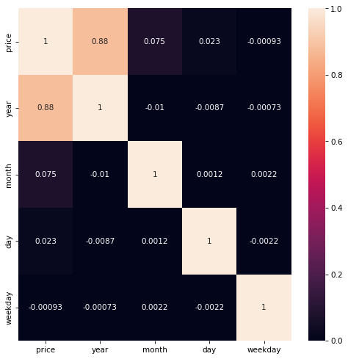
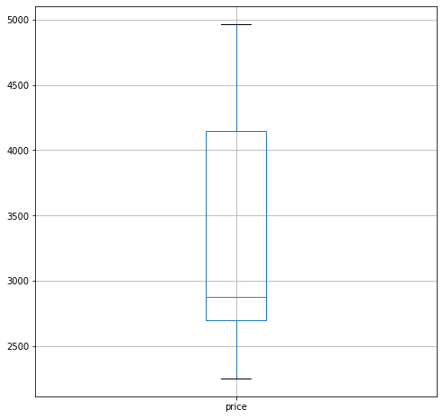
Outliers and Correlation
There is no outlier in dataset price
This is the correlation matrix with the range from
+1 to -1 where +1 is highly and positively correlated and -1 will be highly negatively correlated

Slide 9
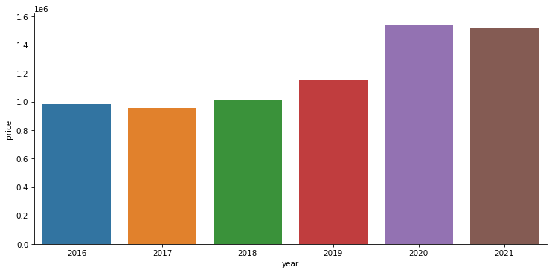
Let visualizing the sum of all sales each year. We can do that using group of “Price” and “Date” and group by “Year”.
We can see that by catplot the price increased in year 2020 & 2021

Slide 10
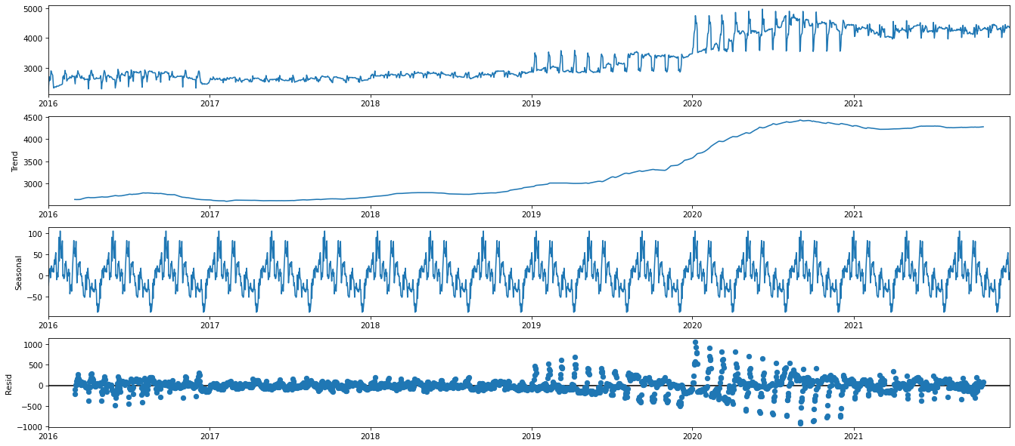
Time series decomposition
Trend - Slow moving changes in a time series, Responsible for making series gradually increase or decrease over time.
Seasonality - Seasonal Patterns in the series. The cycles occur repeatedly over a fixed period of time.
Residuals - The behavior of the time series that cannot be explained by the trend and seasonality components. Also called random errors/white noise.

Slide 11
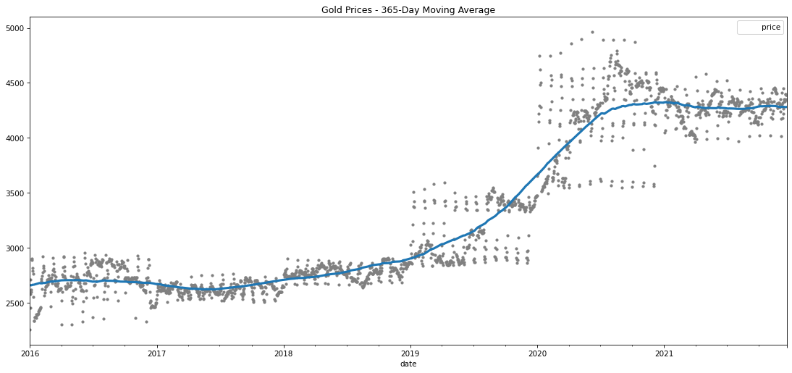
Visualizing changes in mean over 365 days
From the above plot, we can see that there is no constant direction of the mean (increase/decrease) which is understandable as there might be many external factors involved in price fluctuation.

Slide 12
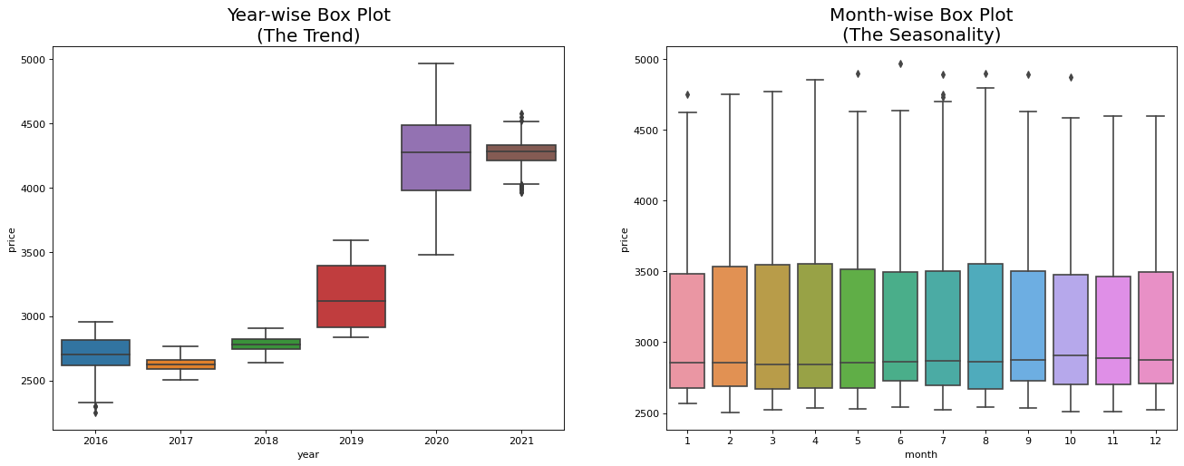
Trend & Seasonality

Slide 13
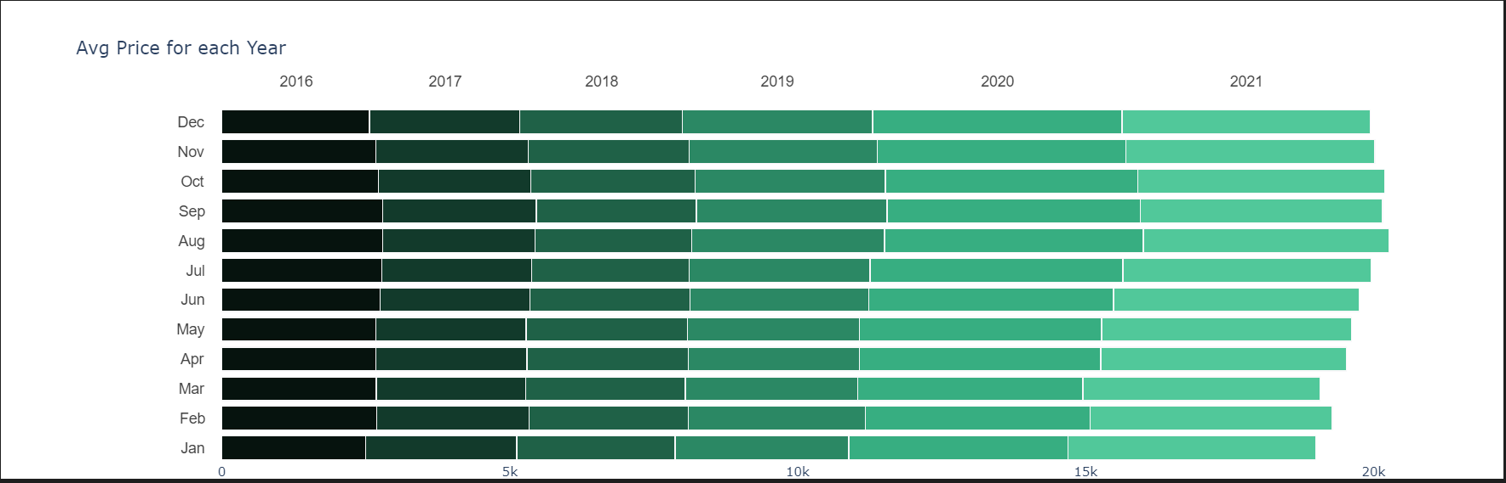
Feature Engineering
Average price of gold for each year
Observation:
* Highest prices of gold are in August to December and the decreased in January to March
* Price are increasing gradually from 2019 to 2021

Slide 14
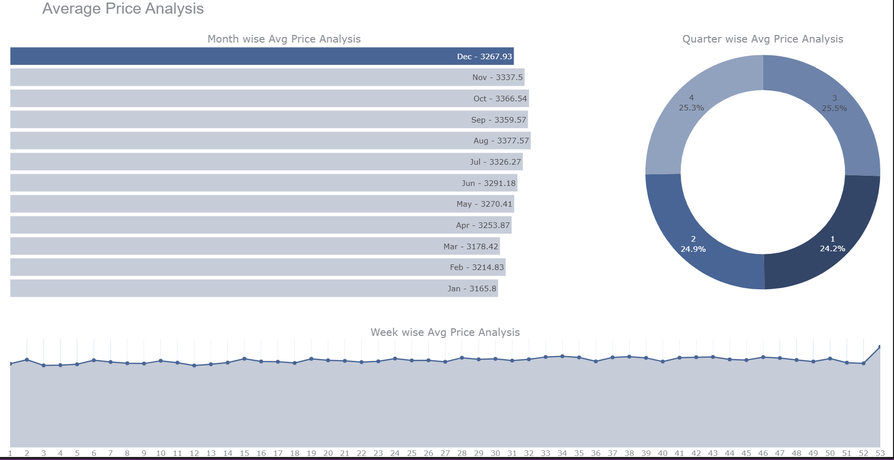
Charts for visualize the Month, Quarter and week wise prices of Gold

Slide 15
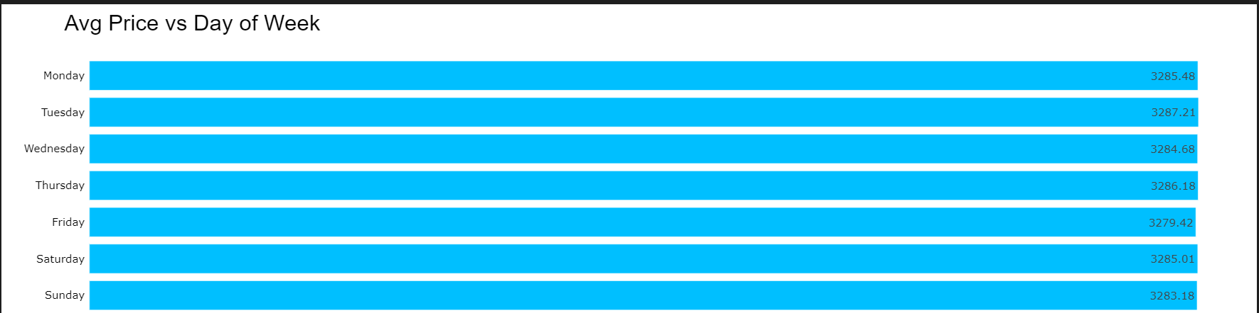
Observation:
As we saw in the above chart there is an upward trend in price of Gold over the time. Although there are ups and downs at every point in time, generally we can observe that the trend increases. Also we can notice how the ups and downs seem to be a bit regular, it means we might be observing a seasonal pattern here too. Let’s take a closer look by observing some year’s data:
Highest price average price is on Tuesday.
August Month has the Highest price.

Slide 16
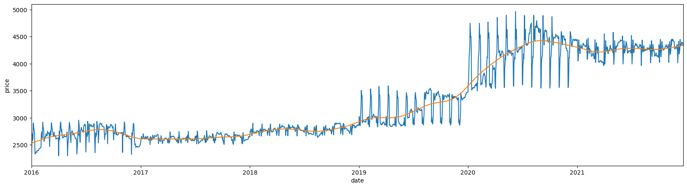
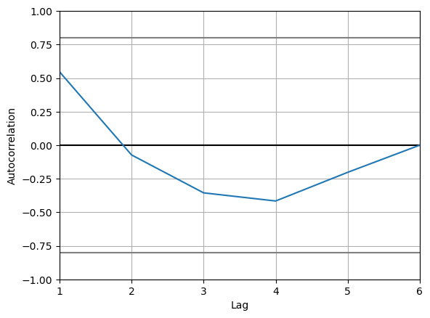
1. Hodrick-Prescott filter
The HP filter is commonly applied during analysis to remove short-term fluctuations associated with the business cycle. Removal of these short-term fluctuations reveals long-term trends.

Slide 17
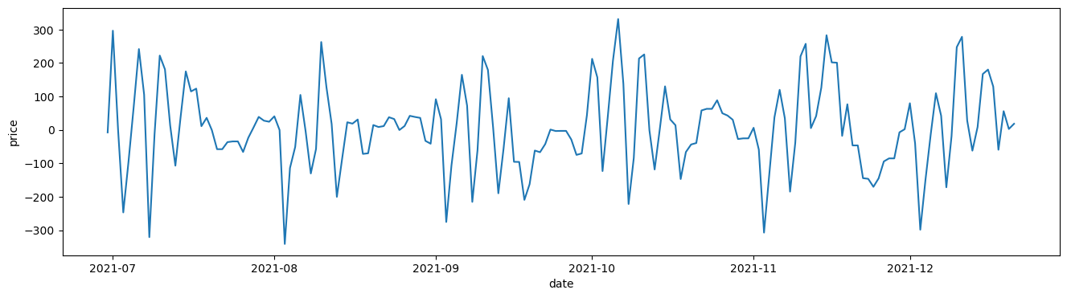
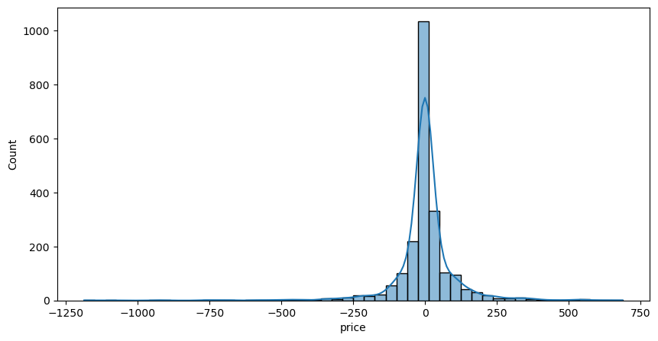

Slide 18
2. Augmented Dickey-Fuller test
Augmented Dickey Fuller test (ADF Test) is a common statistical test used to test whether a given Time series is stationary or not.
ADF Statistic: -21.665.
p-value: 0.000 Critical values (1%): -3.433.
Critical values (5% ): -2.863 Critical values (10%): -2.567.
Dataset is stationary! stat: -21.66454.
p-value: 0.00000 Probably Stationary.
The given Time series is stationary.

Slide 19
3. Kwiatkowski-Phillips-Schmidt-Shin
KPSS test figures out if a time series is stationary around a mean or linear trend, or is non-stationary due to a unit root. A stationary time series is one where statistical properties — like the mean and variance — are constant over time.
stat: 0.01776
p-value: 0.10000
Probably not stationary

Slide 20
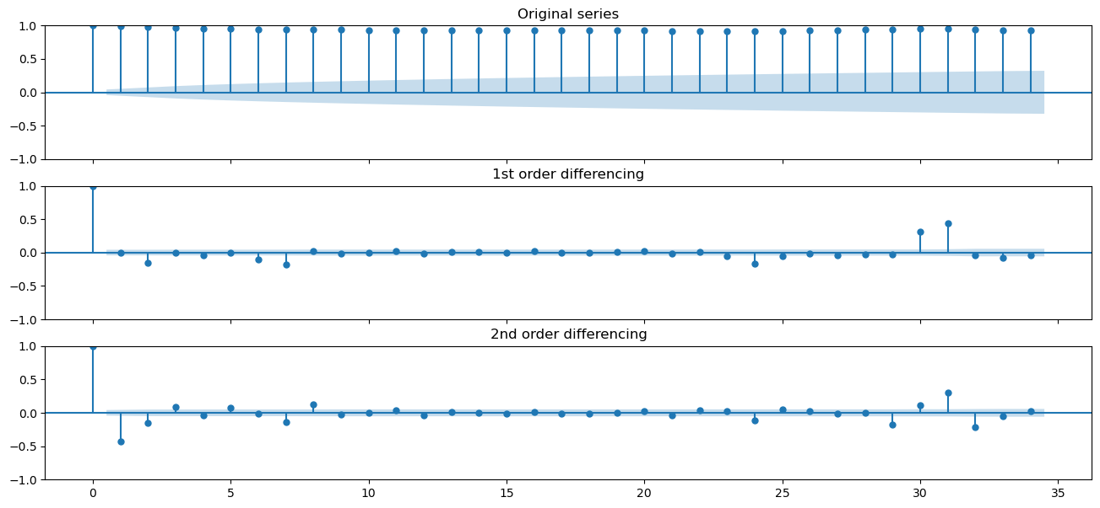
4. Order of differencing (d)
Lags in 2nd differencing fall into negative zone very quickly, indicating the series may have been over differenced. Thus, 1st differencing should be chosen.

Slide 21
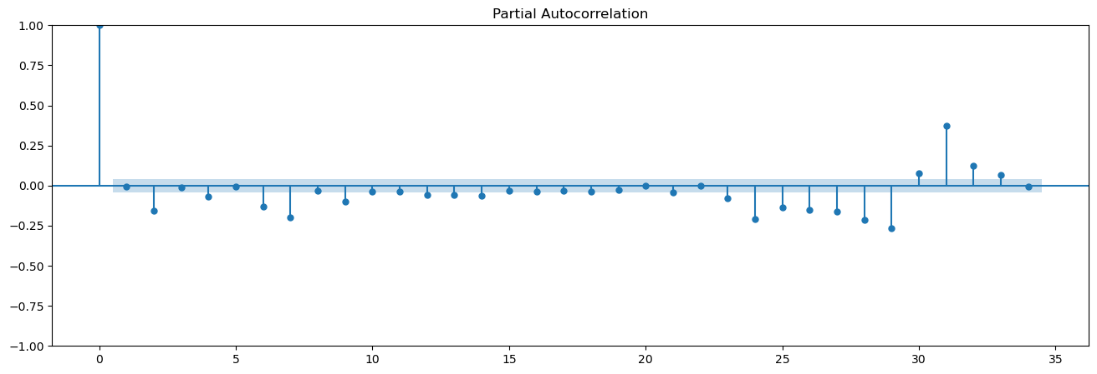
5. Order of AR term (p)
Method of finding p Partial Autocorrelation (PACF) plot correlation between the series and its lag excluding the contributions from the intermediate lags

Slide 22
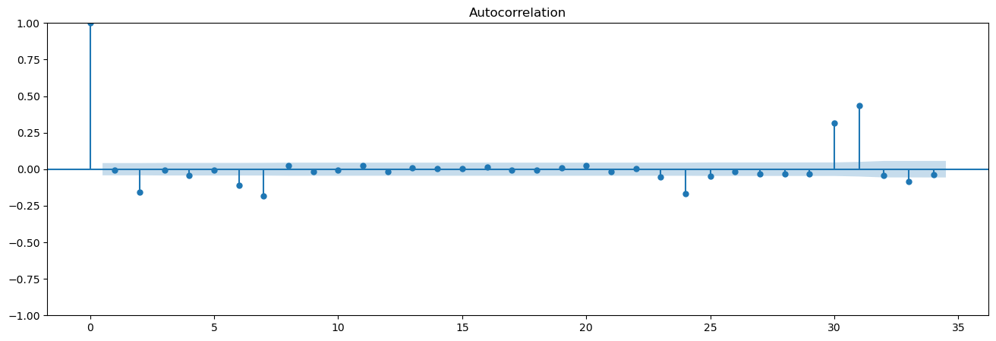
6. Order of MA term (q)
- Definition of MA term (q): - error of the lagged forecast - Method of finding q - ACF * show no of MA terms required to remove autocorrelation in a stationaries series

Slide 23
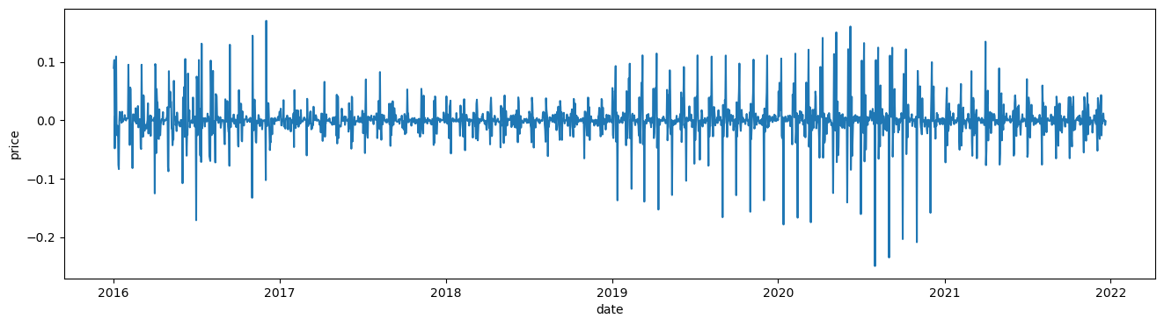
Similar with the result of AR, lag 1 is also far above the significance line than others.
q=1

Slide 24
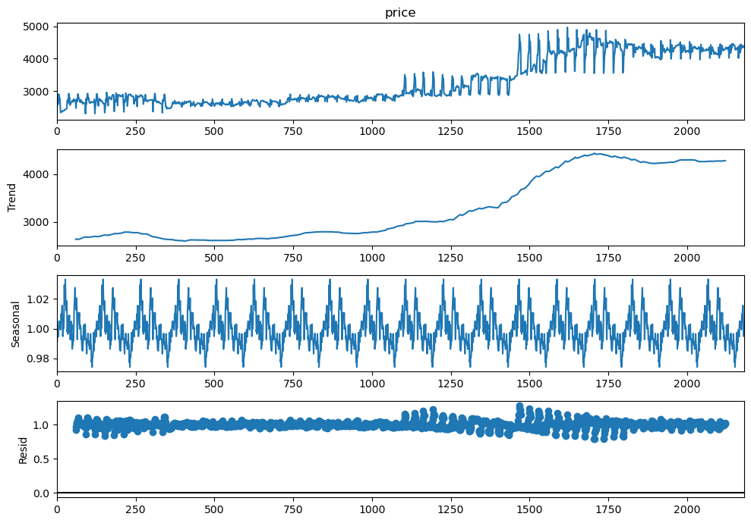
7. Time Series Components
systematic components: level, trend, seasonality non-systematic
component: noise - Level: average value
- Trend: increasing/ decreasing value
- Seasonality: repeating short-term cycle
- Noise: random variation

Slide 25
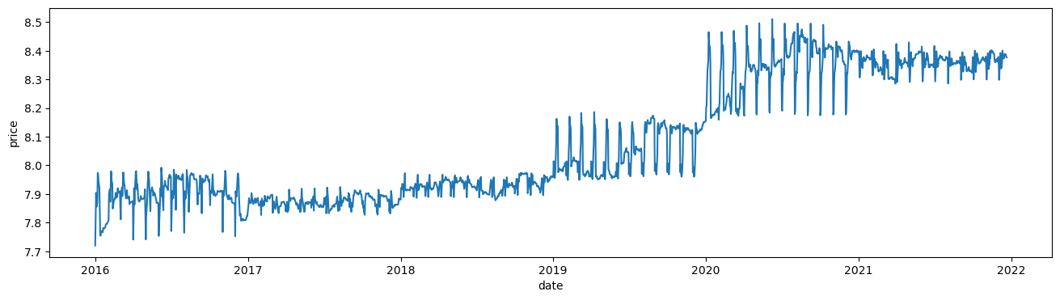
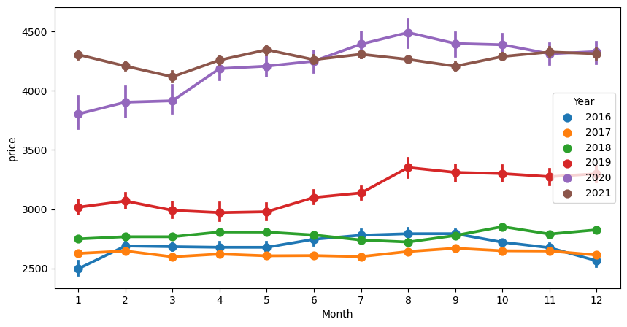

Slide 26
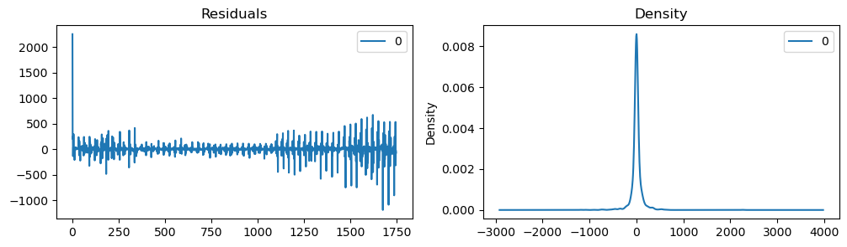
ARIMA model
Although residual errors not mainly around zero, but the variance is uniform.
Note: dynamic=False --> in-sample lagged values are used for prediction

Slide 27
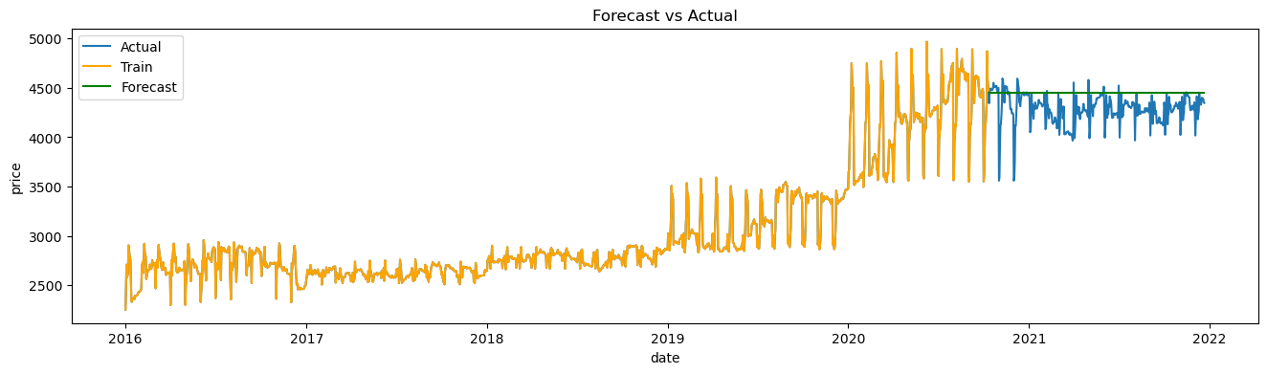
ARIMA Predict

Slide 28
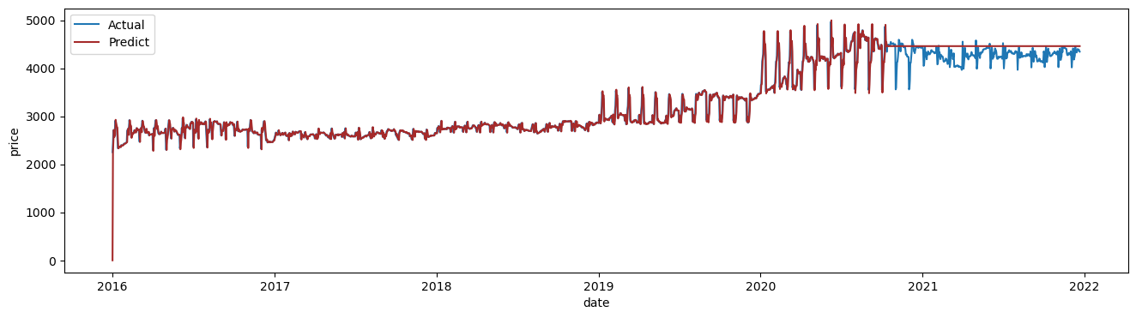
SARIMAX Predict

Slide 29
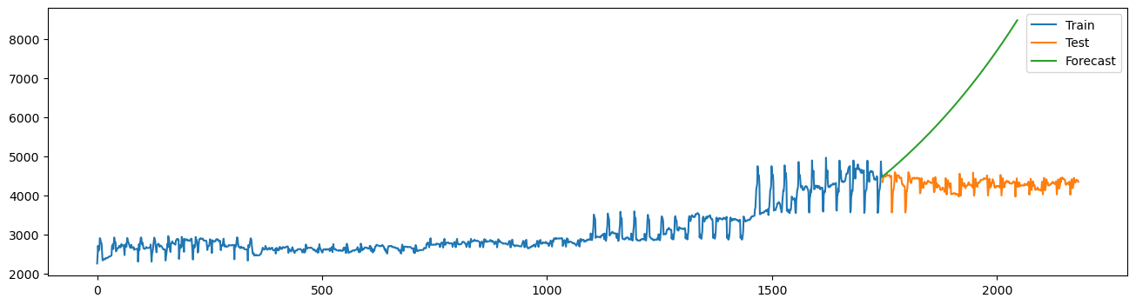
Holt- Winters
Uses exponential smoothing to encode lots of values from the past by computing the combined effects of value, trend and seasonality

Slide 30
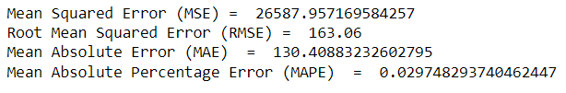
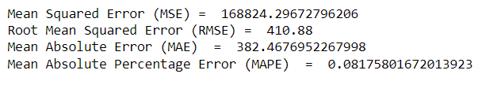
Model Evaluation
RSME Value for the ARIMA, SARIMAX, Holt-Winters
ARIMA Model
SARIMAX Model

Slide 31
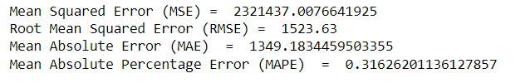
Holt-Winters
Observation: From above observation ARIMA MODEL has lower RMSE value ,hence we are going to deploy using ARIMA Model.

Slide 32
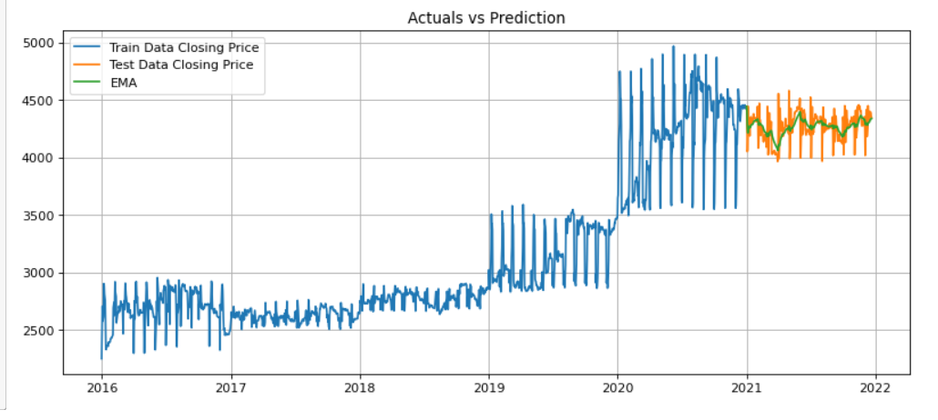
EMA

Slide 33
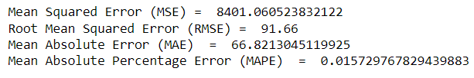

Slide 34
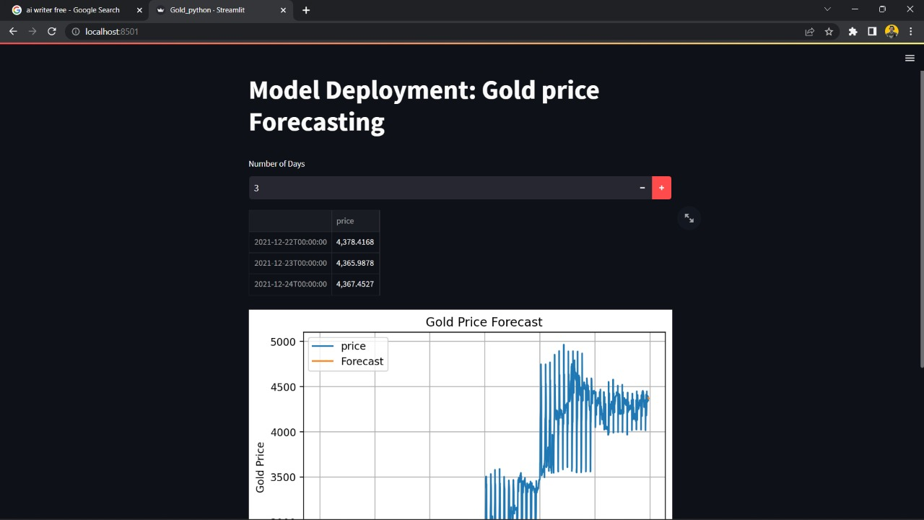
DEPLOYMENT
Deployment Using ARIMA Model.

Slide 35
Challanges Faced while working on project:
While working on the project we encountered error during cross checking the stationary of data
While building model building and implementation phase we encounted errors.
we overcome this challanges by interacting with the team mates and taking their insights, also collecting information from few online sources.

Slide 36
Thank You

